Slide 1
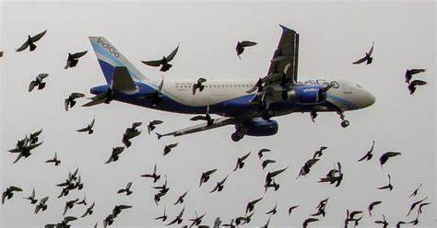
-By CH.Tirumala
Data Visualization of Bird Strikes between 2000-2011

Slide 2

Objective
The goal of this project is to analyse the bird strike incidents happened between 2000-2011. To achieve the goal, we used a data set that is collected by FAA during 2000-2011. The objective of the project is to perform data visualization techniques to understand insights of the data. This project aims apply various Business Intelligence tools such as Tableau or Power BI to get a visual understanding of the data.

Slide 3
Introduction
Transport and Communication Analytics:
Environmental impacts
Safety in urban areas
Increasing number of vehicles and people
Solutions:
Technologies and AI (especially MAS) are crucial
Bird Strikes and Aircraft Safety
Definition:
Collision between a bird and an aircraft (in-flight, take-off, or landing)
Can include bats or ground animals
Common and significant threat
Damage to aircraft structure, especially jet engines
Higher risk during take-off, climb, approach, and landing

Slide 4
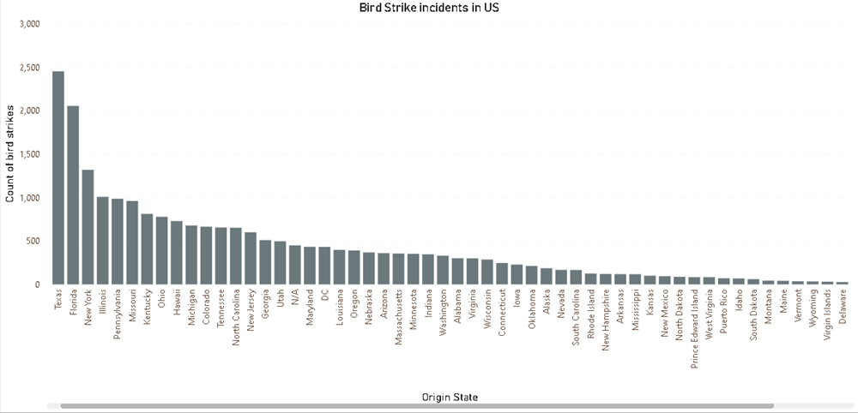
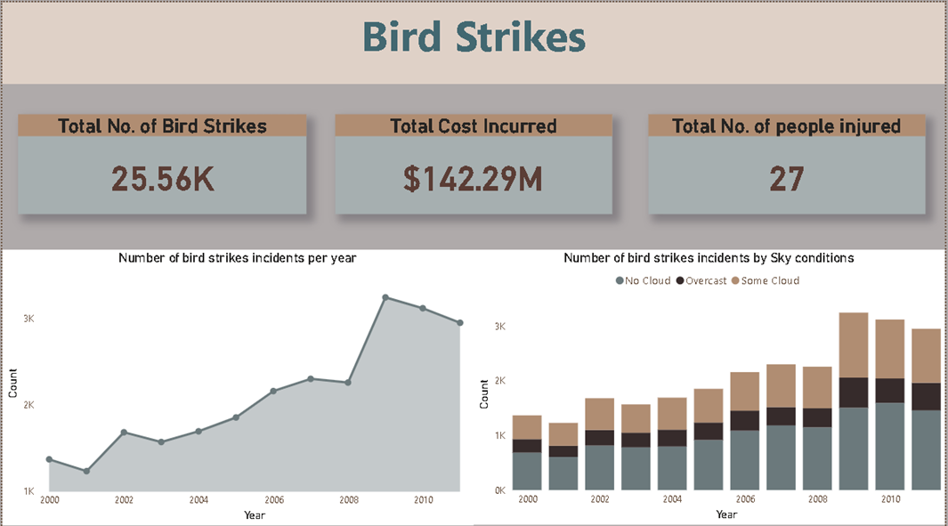
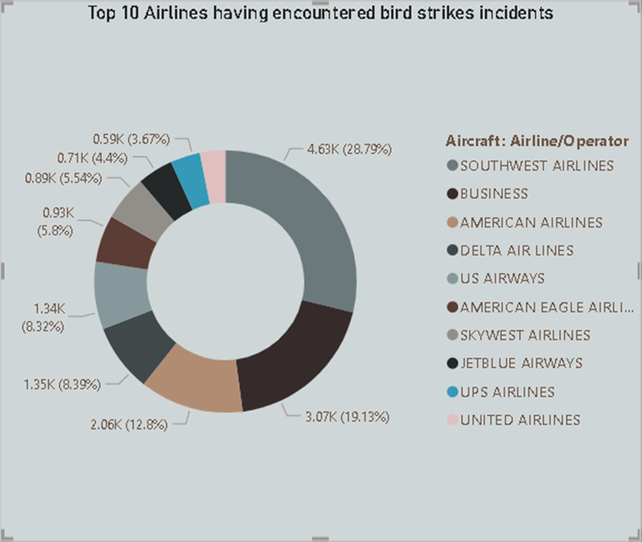
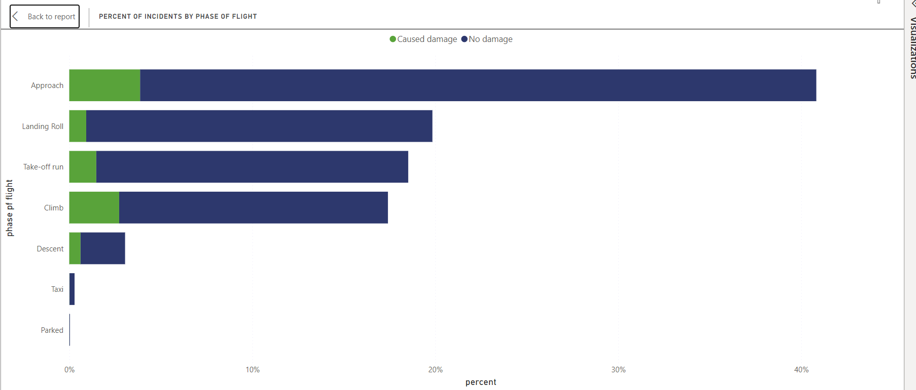
Insights

Slide 5
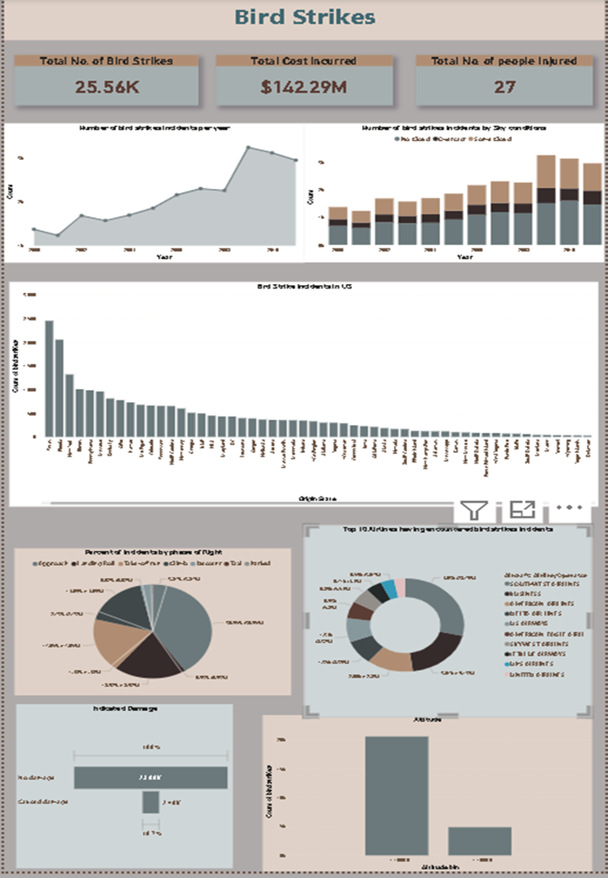

My Design(Dashboard)

Slide 6
Conclusion
42.72% incidents where pilot was warned about the birds
Prior warning to the pilot reduces the risk of damage to the aircraft
52.78% of incidents have happened due to some small unknown bird-
72.9% incidents have happened when there is 1 bird/wildlife is struck in the airplane
and caused damage-
90.31% incidents caused no damage while 9.69% incidents caused damage
80.84% of bird strike incidents have happened when the altitude of airplane was
<IOOO ft and 19.16% have happened when altitude was >IOOO ft.
Most of the incidents have happened when there is no cloud in each year

Slide 7
Thank you

